Slide 1
Задание 2. Используя набор данных на листе «Training» (см. Задания_1_2.xlsx) в качестве обучающей выборки, предсказать значения целевой переменной Target для набора данных на листе «Validate». Пояснить выбор метода. Привести оценки точности и качества предиктивной модели. Построить ROC-кривую. Назвать три наиболее важных предиктора.

Slide 2


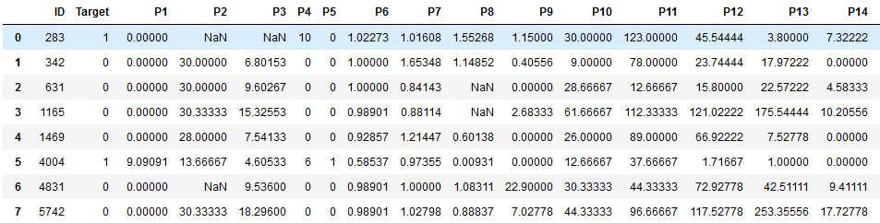
Reading our data and initial review
Looking at the shape of data
Data has 10000 rows and 33 columns
Calculate the number of duplicates
There are no duplicates in the data
Let's look at the data
And columns go further
to P31

Slide 3
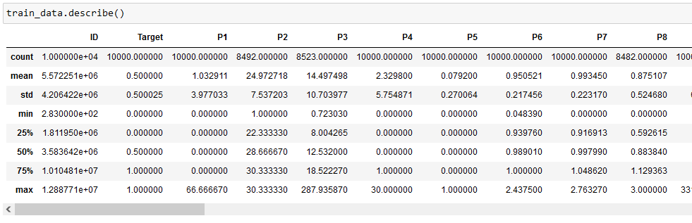
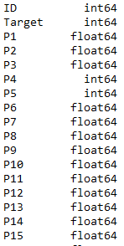
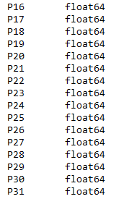
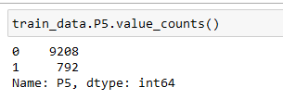
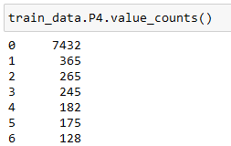

Print summary statistics for each variable
Checking the types of features
However, some features have discrete values:
P5
P4
Target variable
All data are numerical
We also see that the target
variable is balanced
And further to 30
Let’s make lists with categorical and numerical features

Slide 4
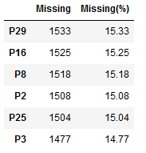
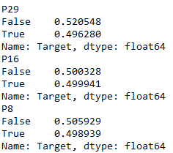
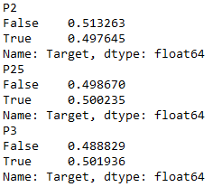
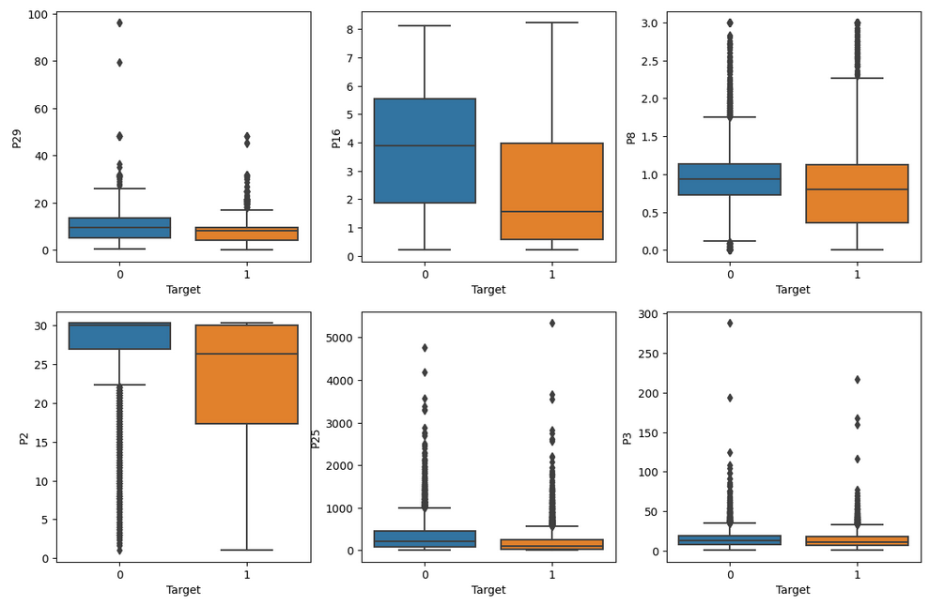
Working with missing data
Print overall count of missing values for features with NANs
Let's check the dependecies between
whether the feature is known and the target
There are about 15% missing values
for 6 features in the data
Let's see how features with missing values
can help us to predict the target.
There are no visible relationships between target
and whether the feature is known or not. All values are close to 50%
We can see that P2 and P16 could be a good predictors

Slide 5
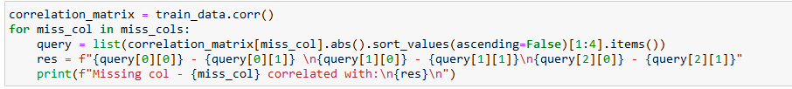
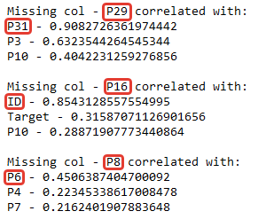
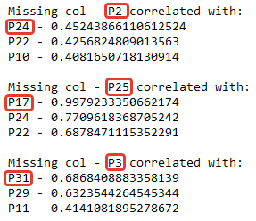
Maybe we can predict the missing values by another column with known features? Let's check the relationships
The output:
We can see some high linear dependencies of variables, let’s make a scatterplots to observe it

Slide 6
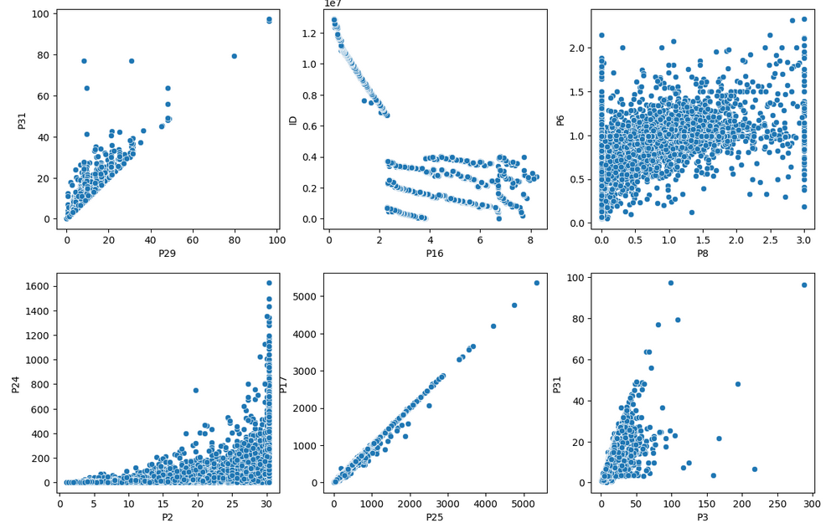
We see high dependencies:
P29 with P31
P16 with ID
P2 with P24
P25 almost linear with P17
P3 with P31
Scatterplots of features with missing data
Let's imput missing values with different approaches:
P29 will be predicted from P31 with linear regression;
P16 will be predicted from ID with DecisionTree;
P8 imput median value, because I don't see some significal relationship;
P2 will be predicted from P24 with DecisionTree;
P25 will be predicted from P17 with linear regression (but probably later we will drop this column because of collinearity problem)
P2 will be predicted from P31 with DecisionTree;

Slide 7
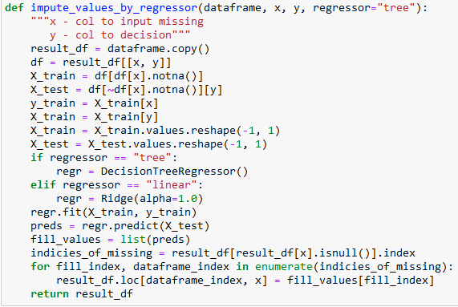
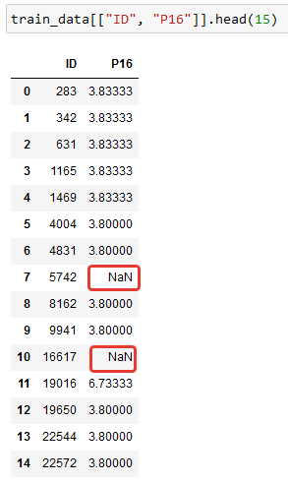
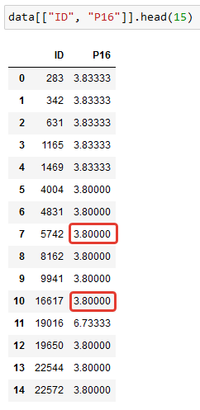
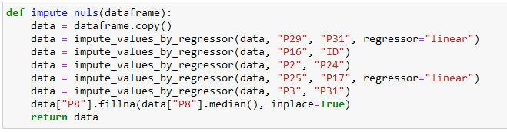

Write a functions for imputting missing values by regressor model
For self-checking let's see how it handles ID and P16:
Imput other features
Looks like the truth
Okay, now we don't have any missing values in data

Slide 8
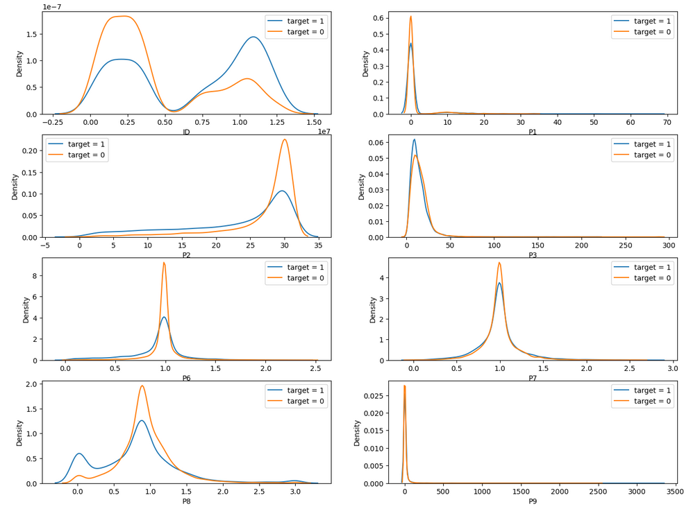
Working with numerical cols
Now we plot the KDE charts for each variable to observe relationships with the target value
Features ID to P9
Features ID and P8 could be a good predictors
Features P1, P7, P9 probably will not help us

Slide 9
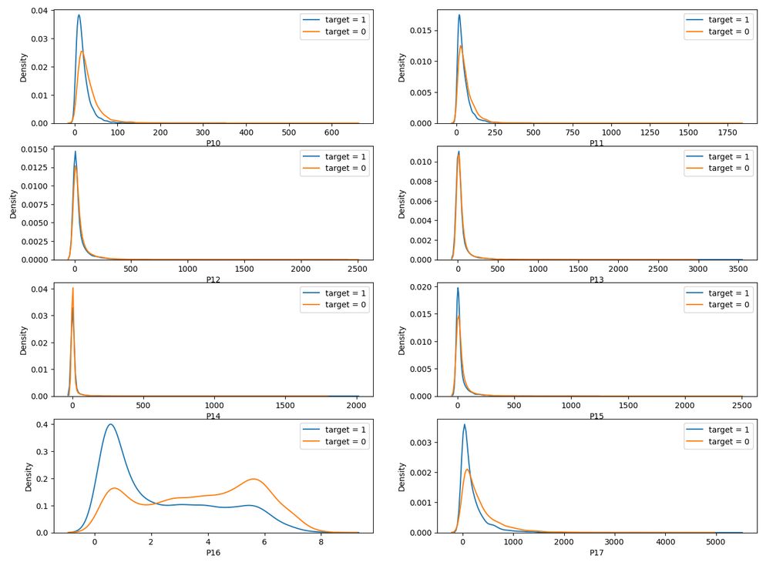
Working with numerical cols
Features P10 to P17
Feature P16 could be a good predictor
Features P12, P13, P14
are not likely to help us

Slide 10
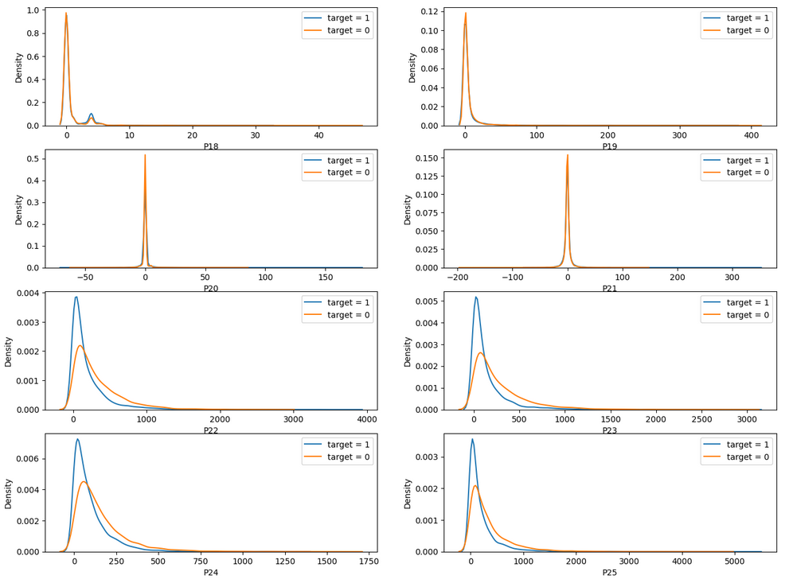
Working with numerical cols
Features P18 to P25
Feature P23, P24 could be a good predictors
Features P18, P19, P20, P21
are not likely to help us

Slide 11
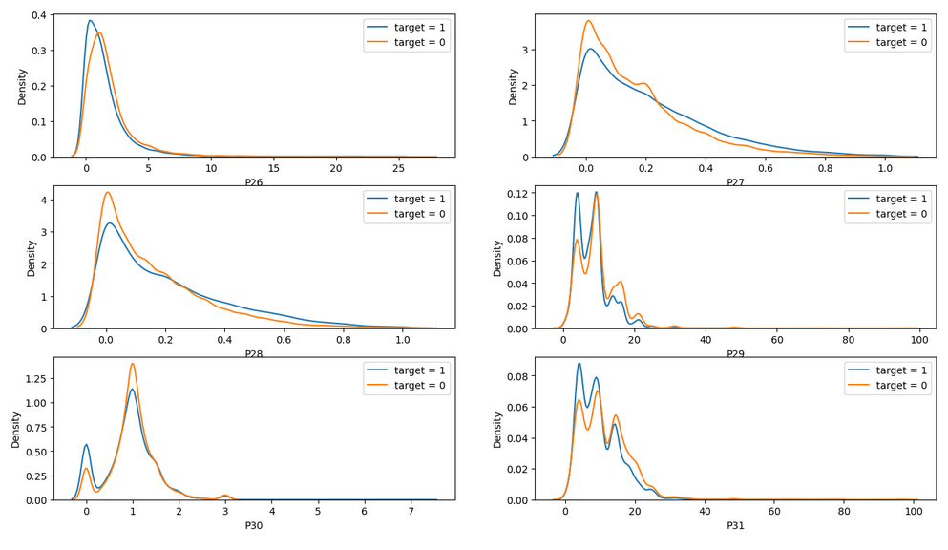
Working with numerical cols
Features P26 to P31
Feature P29, P30, P31 could be a good predictors
After looking at all this charts we can make some conclusions:
P1, P3, P7, P9, P13, P14, P19, P20, P21, P5, P18 will not help us to predict the target. And we can drop it for dimensionality reduction

Slide 12
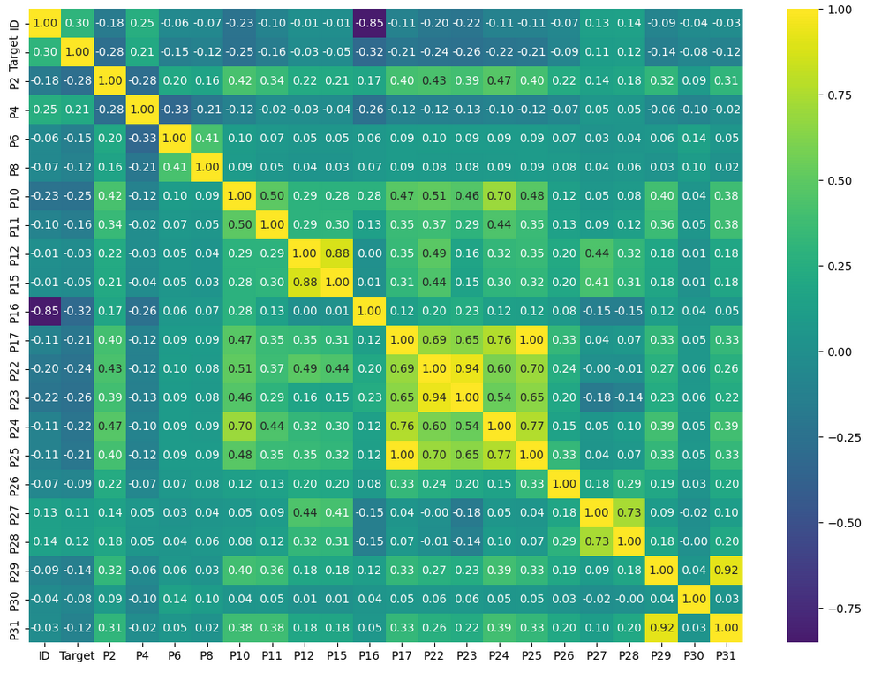
Plot the corr matrix between other features to see linear dependencies between features
P17 and P25 are linearly dependent features. We can drop one of them
Also we can see that the features ID, P2, P4, P10, P16, P22, P23 have the highest correlation with the target variable

Slide 13
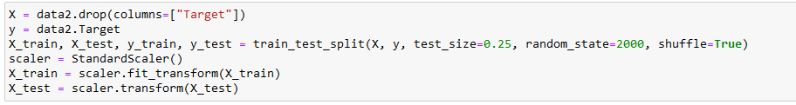
Predictions
Some preparing of data for prediction:
split to train and test set (75% : 25%)
Z-score scaling of numerical columns
We have only 10.000 samples in training data. And many noisy features. Let's use simple Logistic Regression model with L1 regularization.
Classes are balanced in target (50/50). So we can use accuracy metric for intermediate testing
Accuracy - 0.71, not very good, but better than a random predictor

Slide 14
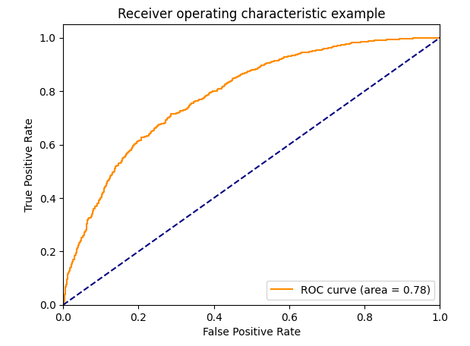
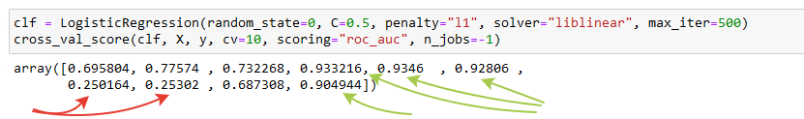
Plot the ROC curve
Let's do the cross-validation technique with 10 folds and roc-auc metric for more accurate estimation
Look's very interesting. We have very different results by each fold. Some of folds have 0.25 score, when another has 0.9 and more.
ROC-AUC score is 0.78
Let’s make another train/test partitioning, with 0.1 test size and without shuffling the data.

Slide 15
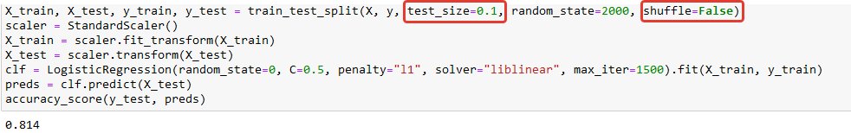
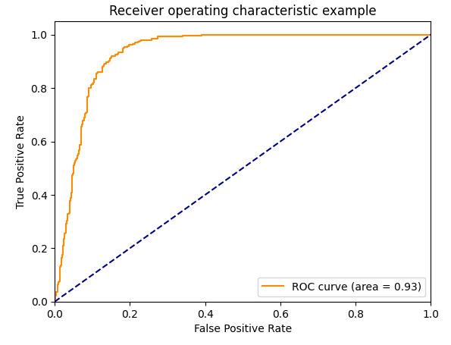
Plot the ROC curve
Accuracy score increased to 0.81 and ROC-AUC to 0.93.
Probably we have some anomaly examples in our dataset. And it greatly affects the results depending on the splitting of the data. Examples with indexes from 7300 to 9300 have 2000 consecutive "1" in target. And from 9300 to the end have 700 consecutive "0". But we don't know where are our data came from and maybe these values also make sense. So let's just leave it at that.
ROC-AUC score is 0.93

Slide 16
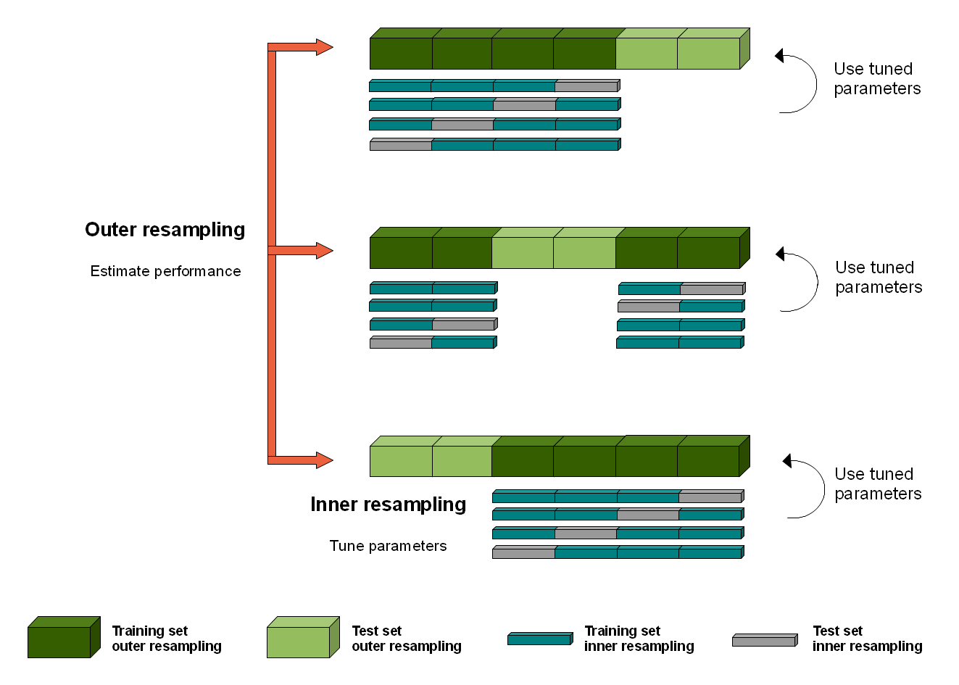
To get an unbiased estimate of our model with this data we will use Nested-Cross-Validation
An example of how it works

Slide 17
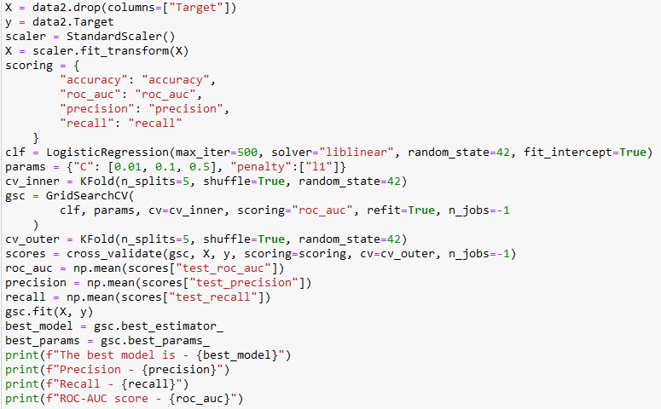
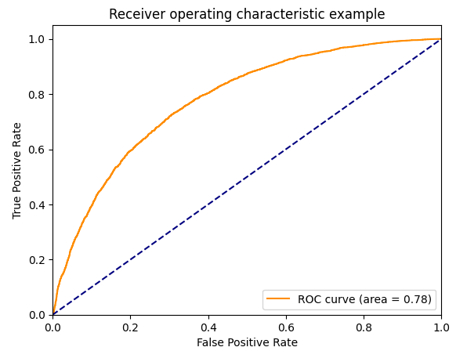

The code for running Nested-CV
Plot the ROC curve
Our final ROC-AUC is 0.78. With this data maybe it is not very bad.
The output

Slide 18
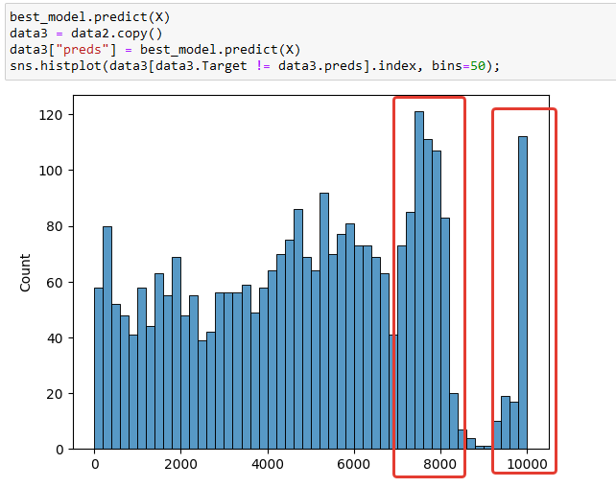
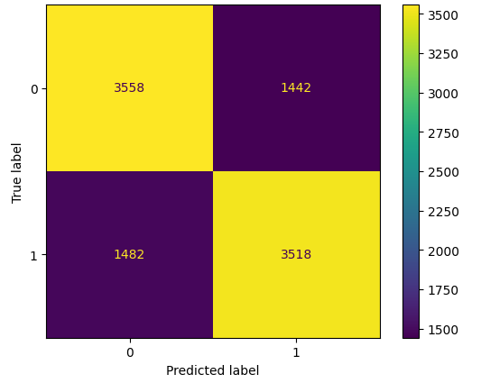
Let's see where we got the most of false results
Plot the confusion matrix
We have approximately the same count of false-positives and false-negatives. (1442 and 1482)
The most of faults is concentrating near 7000 - 8000 rows and 9500 - 10000 of our data. Maybe there are very noisy data.

Slide 19
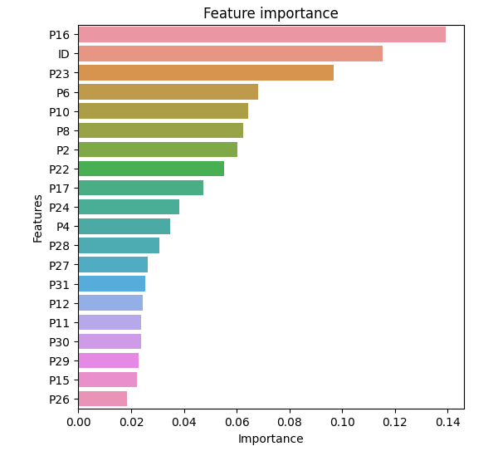
Feature importance
"ID", "P16" and "P23" are the most
important features for target prediction.
Thanks for watching!

